Slide 1
Pixelbling Notes 1-4-2013
1) Created account on website for test2@pixelbling.com. I Chose Free trial.
Did not send “Welcome email” to new user. User: test2 Password: pass12
2) Web site: Tried to log on with test2. Gave error message: You did not enter the correct username/password combination.
User: test2 Password: pass12
3) ADIM: test2@pixelbling.com Free Trial. Expiration is set to 0000. Is set to Basic Service. And is not Active.
4) Web Site: Click forgot password for test2. Did not send email. I assume its because Account is not Active.
5)Linda tried to create a NEW ACOUNT. It said she already existed. She does not exist because I deleted it last month. Sounds like it still holding on to info.
She then sent a request to send her the password. Nothing was sent.
6) Account User “belo” not able to see Advanced themes.

Slide 2
6) Account User “belo” not able to see Advanced themes.

Slide 3
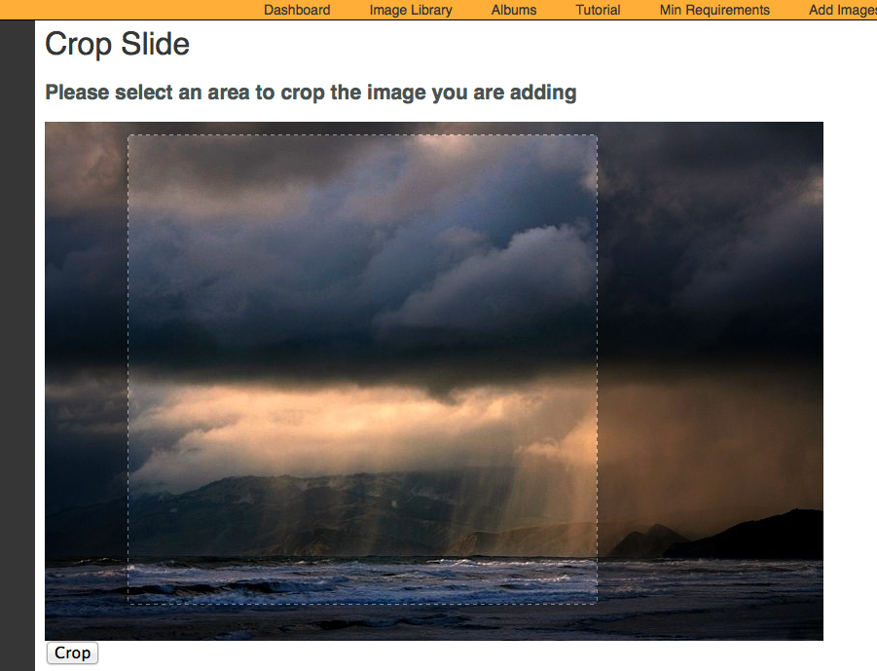
7). Need to revisit the crop aspect ration. Needs to proportionate scale.

Slide 4
RECAP: SERVICE PLANS
SERVICE PLANS: Both Service Plans include the following. You’ll have the capability to receive and organize your photos, create slides, and play them from your PC onto the air.
•Pixelbling Parses photos from the email address(es) and send them to an Image Library. • Viewers submit their photos designated email address. • Image Library that sorts and organizes Photos. • Create Multiple Albums • Fullscreen photo templates with text field • Fullscreen Mode for On Air Broadcast • Upload Pics from desktop • Dynamic Transitions • Editing Tool for Images.
I. STANDARD PLAN $220/mo
This plan is a basic plan that gets your viewer pics straight to the air with ease. Viewers submit their photos to ONE designated email address.
Templates:
•FS Weather Photo w/text
•FS Generic Photo w/text
•FS Birthday Photo w/text
Transitions:
•Cube
•Slide
•Blinds 3D
II. ADVANCED PLAN $350/mo
This plan gets you everything in the Basic plan, plus the capability for much more customization.- Viewers submit their photos to 1-3 designated email address.
Templates:
• FS Weather Photo w/text
•FS Generic Photo w/text
•FS Birthday Photo w/text
•FS Celebrity Birthday w/text
•FS Headshot / Mug w/text
•FS Facebook Text Only
•FS Twitter Text Only
Transitions:
•Turn
• Cube
•Bars 3D
• Slide
• Concentric
• Blinds 3D

Slide 5
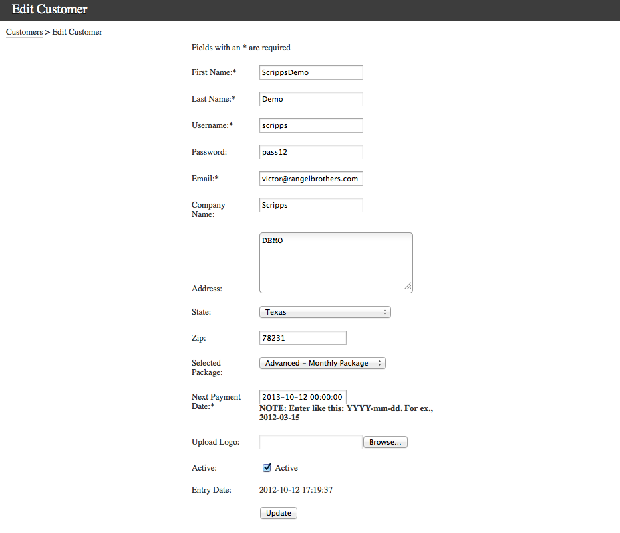
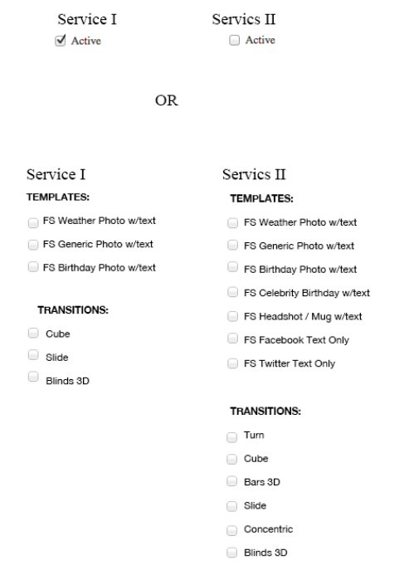
8). In ADMIN Dashboard, Would Like the option of assigning Service I or Service II, to any user that we create through admin.
Is this type of activation possible? Example Below.

Slide 6
8). Continued.

Slide 7
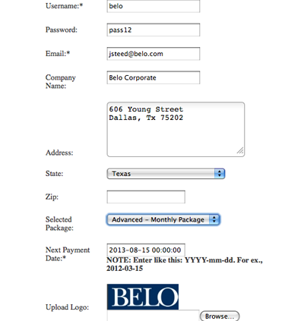
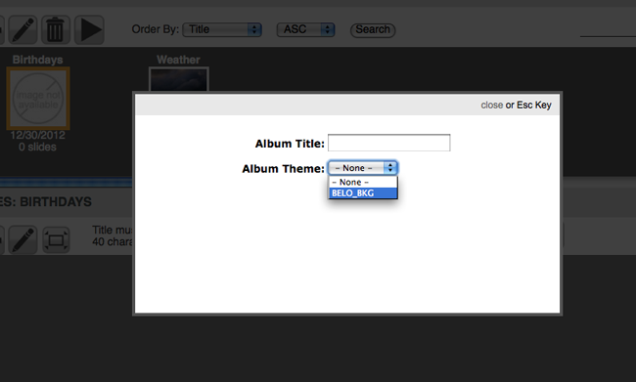
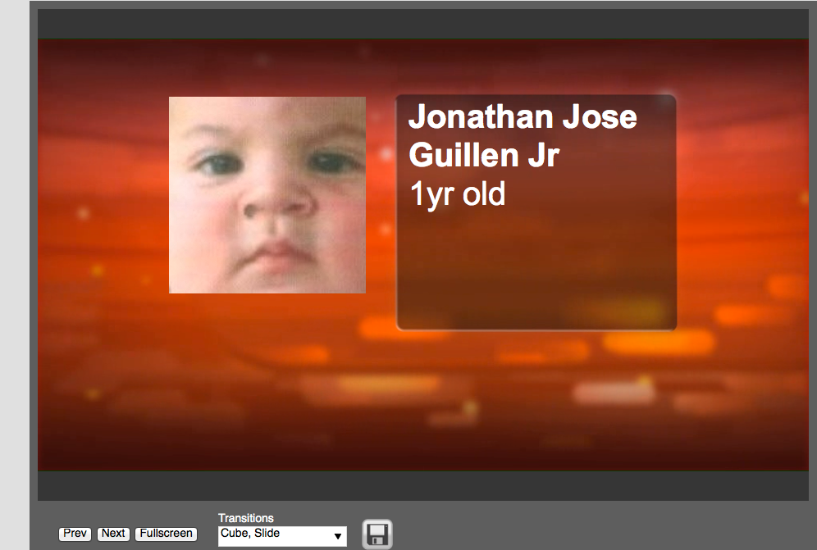
9) Advance Service not showing All of the Album themes. When I create a New Album there is only one theme to choose.
10) Head Shot Template – When in Full Screen Mode, Photo is to small. However the Preview is OK.

Slide 8
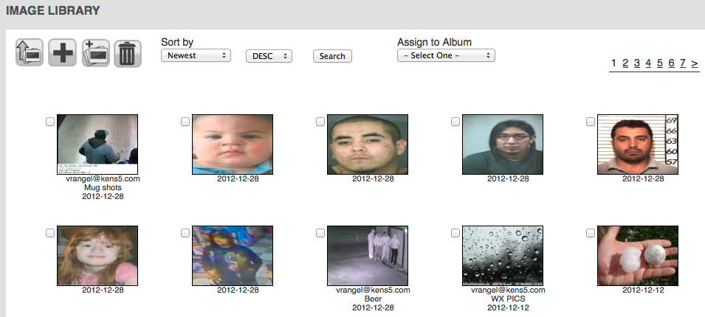
11) Image Library– Meta data on each photo jpeg file does not come through. i.e. The title or filename of each photo. The time stamp is OK.

Slide 9
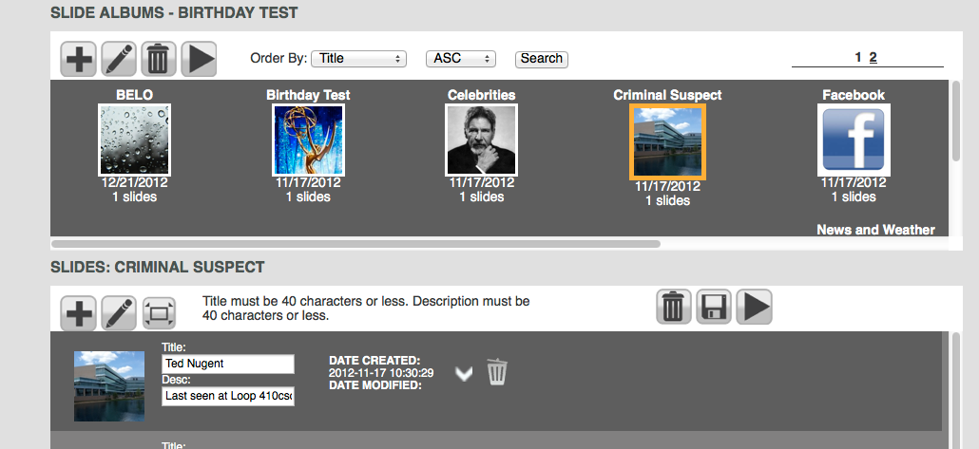
12) Slide Album – “title” does not change according to Album Selected. They should correspond to the Album selected.

Slide 10
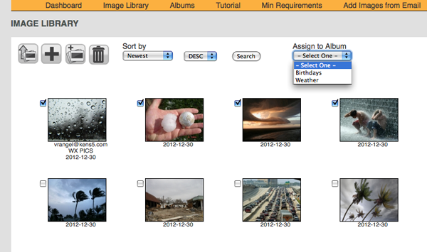
13) Image Library: When user selects images to Add to Album, User can Create New Album, and Choose from Drop Down Menu. Please add “New Album”.
New Album

Slide 11
14) Not sure what is “edit icon” does?
15) Not sure what is Add “new blank slide” is?
16) Fullscreen mode should look like the play button. Remove or Move Play button next to Edit icon.

